Slide 1


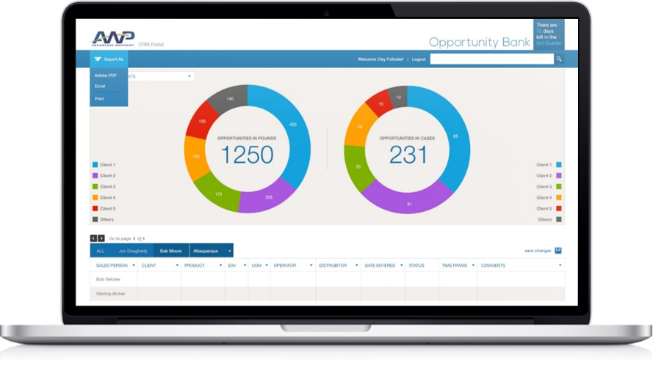
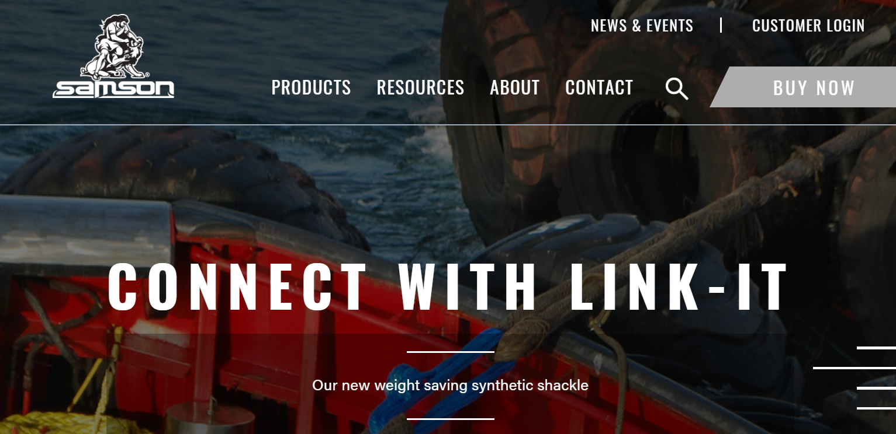
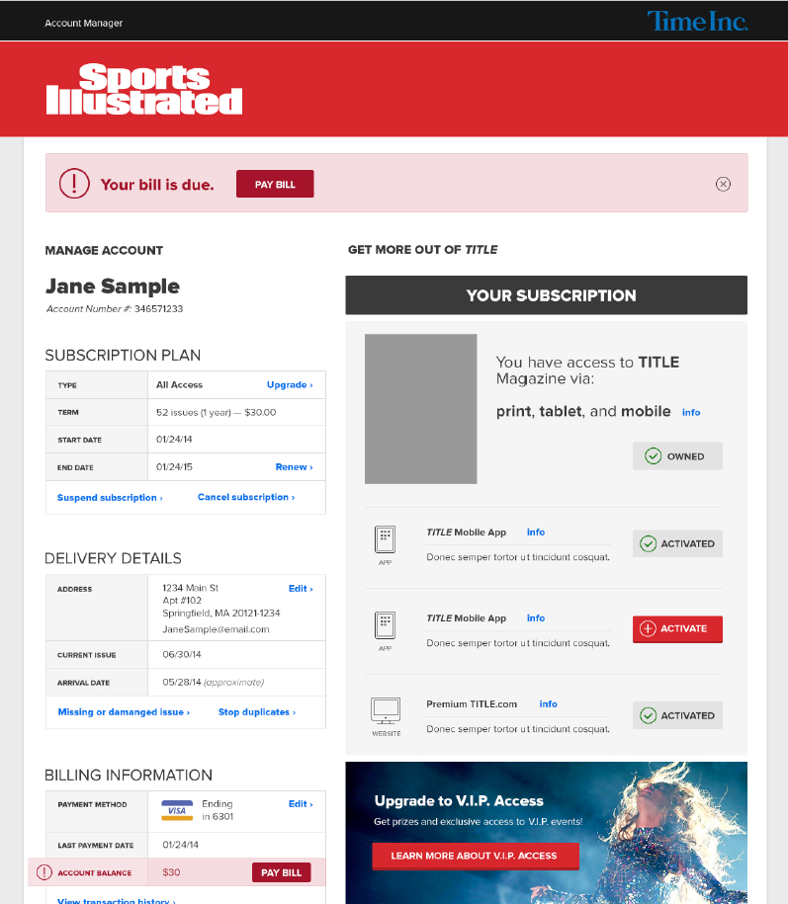
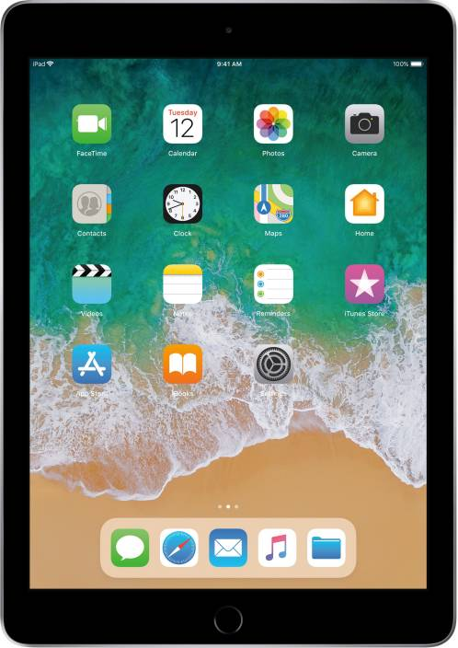
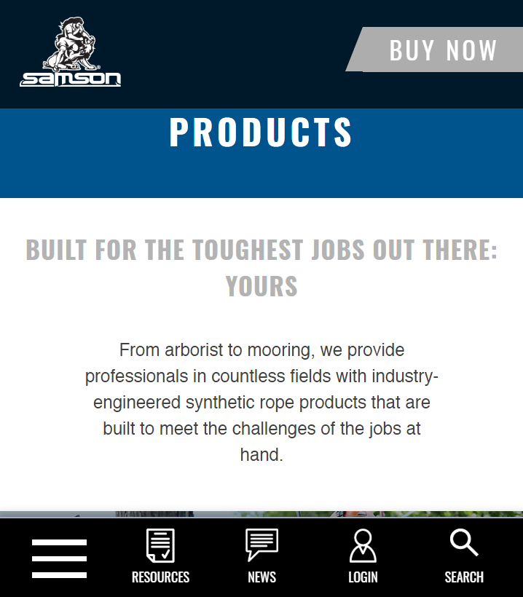
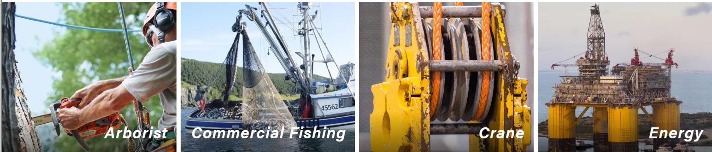
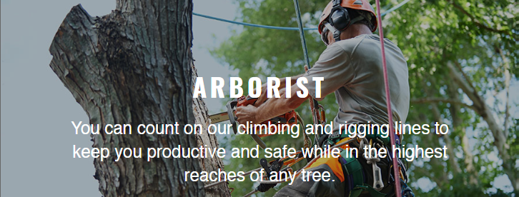
Samson Rope
Who They Are
Samson is at the forefront of the synthetic rope industry, recognized as a worldwide leader in high-performance synthetic ropes, Samson is utilizing the latest innovative fibers and proprietary constructions and coatings to design the perfect rope for each unique application. Samson Rope have engaged with us on several varying projects but most recently Affirma is supporting their Sitefinity Website.
What We Did
Samson Rope reached out to get support for their current Sitefinity Website
Updated current standardized safety requirements for specific rope
Provided wireframes for website updates
Refreshed UX/UI
Results
On-time and on budget
Improved usability
Overall improvement to website
https://www.samsonrope.com

Slide 2
Samson Rope
Business Need
Samson is at the forefront of the synthetic rope industry, recognized as a worldwide leader in high-performance synthetic ropes, Samson is utilizing the latest innovative fibers and proprietary constructions and coatings to design the perfect rope for each unique application. Samson Rope have engaged with us on several varying projects but most recently Affirma is supporting their Sitefinity Website.
What We Did
Samson Rope reached out to get support for their current Sitefinity Website
Updated current standardized safety requirements for specific rope
Provided wireframes for website updates
Refreshed designs

